Slide 1



Garbage Classification

Slide 2

Learning Objectives
Understand the basics of image classification using deep learning.
Learn how to preprocess and augment image data for training CNN models.
Explore transfer learning using pretrained models like EfficientNetV2B2.
Implement a garbage classification model to identify different waste types.
Handle class imbalance using weighted training techniques.
Visualize model performance using confusion matrices and class distribution plots.
Build a user-friendly interface using Gradio to test the model in real time.
Learn how to optimize and deploy deep learning models for real-world applications.
GOAL
Source :
www.freepik.com/

Slide 3
Tools and Technology used
Python: Core Programming language used for building the model and logic.
TensorFlow & Keras: Deep learning frameworks used for model building and training.
EfficientNetV2B2: Pretrained CNN architecture used for efficient garbage classification.
NumPy & Matplotlib & Seaborn: Used for data manipulation and visualization (class distribution, confusion matrix).
Scikit-learn: Used for computing class weights and evaluation metrics.
Gradio: For creating a web-based interactive interface to test the model with images.
Jupyter Notebook : For code experiment, visualization and model development.
Streamlit: For app deployment with enhanced UI
GitHub: Source code hosting and version control.

Slide 4
Methodology
Problem Definition:
Identify the need for an automated garbage classification system to improve waste management efficiency.
Data Collection & Preparation:
Dataset containing labeled images of garbage categories such as paper, cardboard, plastic, metal, glass, and trash.
Split data into training, validation, and testing sets using { image_dataset_from_directory() } with an 80-10-10 or 80-20-20 split.
Preprocess image to a uniform shape( e.g., 124*124*3) and normalize pixel value using preprocess_input().
Data Augmentation:
Apply techniques like random flip, rotation, zoom, and contrast adjustment to increase data diversity and prevent overfitting.
Model Architecture:
Use EfficientNetV2B2 as a base model with pretrained weights(imagenet) and without the top layer.
Add custom layers:
GlobalAveragePooling2D
Dropout
Dense output layer with softmax activation for multiclass classification.

Slide 5
Methodology
Training:
Compile the model using Adam optimizer and (sparse_categorical_crossemtropy) loss.
Train with EarlyStopping and class weights to handle class imbalance.
Monitor accuracy and loss over epochs.
Evaluation:
Evaluate model performance on the test set.
Plot confusion matrix and compute precision/recall for deeper insights.
Deployment:
Build a front-end using Gradio to allow users to upload images and receive predictions.
Display top 3 predicted categories with confidence scores.
Future Scope:
Optionally deploy the app on Streamlit, and later connect with IoT devices (camera/sensors) for real-world smart waste management.

Slide 6
Problem Statement:
To develop an accurate and efficient garbage classification model using EfficientNetV2B2 and transfer learning for automated waste sorting.

Slide 7
Solution:
A deep learning model was built using EfficientNetV2B2 architecture to classify garbage into 6 categories.
We made key improvements to the base model, including:
Applied data augmentation (random flip, rotation, zoom, contrast) for better generalization.
Added EarlyStopping to prevent overfitting and restore best weights.
Used class weights to handle class imbalance effectively.
Modified the prediction logic to show top 3 predictions with confidence scores, rather than just one.
Enhanced the user interface using Gradio:
Live webcam support.
Clean and responsive UI.
Displayed prediction time for better user feedback.
Final goal: To deploy the model using Streamlit for real-world use in garbage detection via camera or sensors.

Slide 8
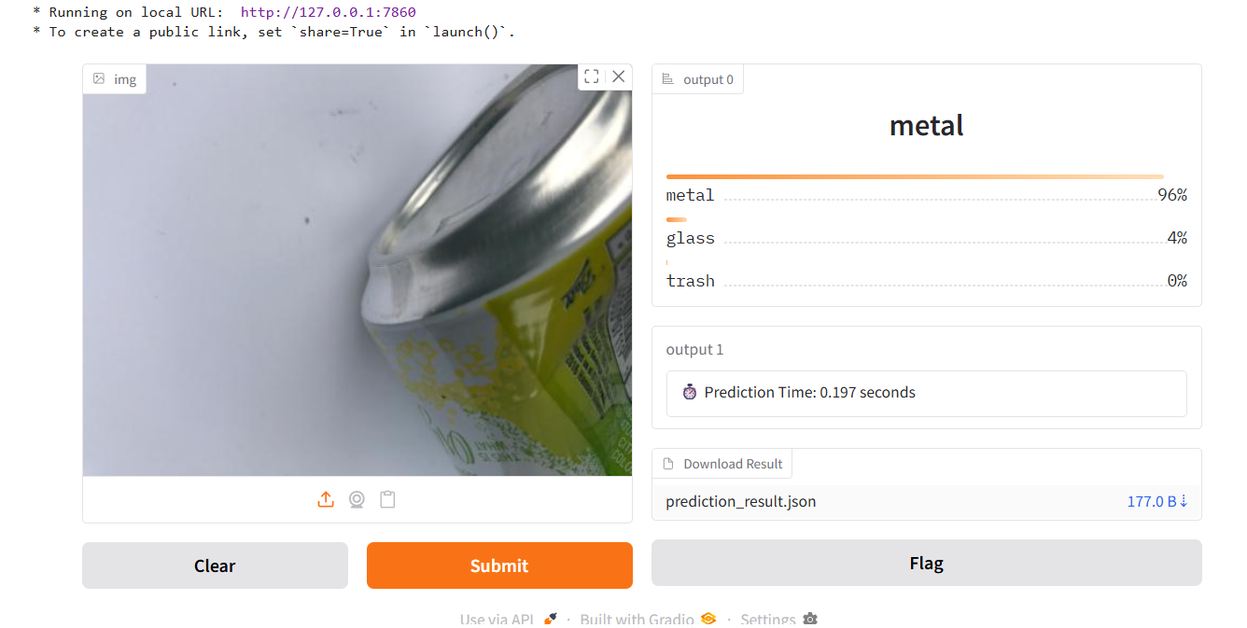
Screenshot of Output:

Slide 9
Conclusion:
This project successfully demonstrated the use of deep learning and transfer learning to automate garbage classification with high accuracy.
By implementing EfficientNetV2B2, along with data augmentation, class balancing, and early stopping, the model was optimized for real-world performance.
The integration of Gradio UI made the system interactive and easy to use, offering live webcam input and clear prediction outputs.
These enhancements not only improved the model’s robustness but also added real-world applicability by simulating how such a model could be deployed in smart waste management systems.
Going forward, this solution can be integrated with IoT devices or cameras in public spaces for automated garbage sorting, contributing to cleaner cities and sustainable living.

